Slide 1

DECODING CAR INSURANCE: EXPLORING PREDICTORS OF ANNUAL PREMIUMS
By:
Andrew Prem Robert
Abdel Ouedraogo
Hemanth Kothapalli
Nhut Quang Ly

Slide 2


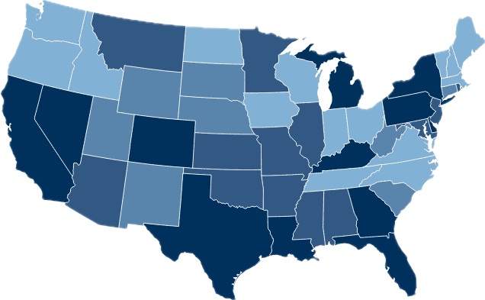
Table of Contents
Introduction​
Data Dictionary
Data Collection and Processing
Summary Statistics
Data visualization​
Regression Results of Models
Observation of Models
Insights from Analysis​
Model Evaluations and Strategic Perspectives

Slide 3

Introduction
In the context of car insurance, a premium refers to the regular payment made to an insurance company for coverage over a specified period, typically six or twelve months. This payment ensures that the insurer will provide financial protection as outlined in the insurance policy, including liabilities and collision coverage.
What factors affect Car Insurance Premiums? Typically, they are influenced by factors including driving record, vehicle type, location, age and many more!

Slide 4


Variable | Data Type | Possible Values
id | Numeric | Unique numerical identifiers
Gender | Factor | Male, Female
Age | Numeric | Integer values representing age
Driving License | Numeric | 0 (No), 1 (Yes)
Region Code | Numeric | Integer codes for different regions
Previously Insured | Numeric | 0 (No), 1 (Yes)
Vehicle Age | Factor | < 1 Year, 1-2 Year, > 2 Years
Vehicle Damage | Factor | No, Yes
Annual Premium | Numeric | Continuous numerical values
Policy Sales Channel | Numeric | Integer codes for different sales channels
Vintage | Numeric | Integer values representing the number of days associated
Data
Dictionary

Slide 5

Data Collection and Processing
Collected data and cleaned it to ensure accuracy and consistency.
Checked for any double values or missing values which may skew our results.
Utilized Data Visualization in R to identify outliers, uncover patterns, and visualize trends, enhancing data comprehension.
Converted certain variables such as 'Region Code' and 'Policy Sales' into factors to facilitate more effective analysis of the models.

Slide 6

Summary Statistics
Variable | Min | Median | Mean | Max | Count
Age | 20 | 36 | 38.77 | 85 | 127037
Annual_premium | 2.630 | 31.462 | 30.525 | 472.042 | 127037
Vintage | 10 | 124 | 160 | 299 | 127037
Substantial disparity between the minimum and maximum values, indicating a heightened probability of outliers or data inaccuracies.

Slide 7
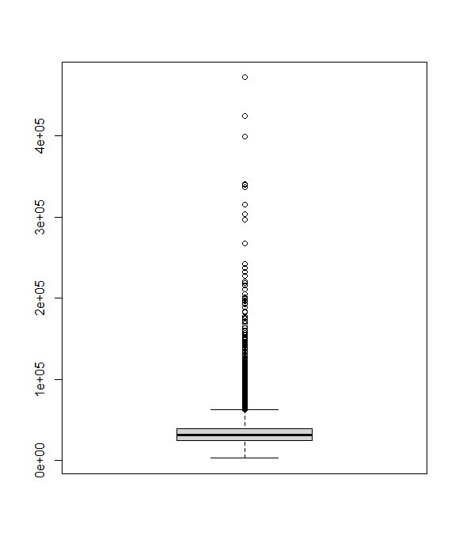
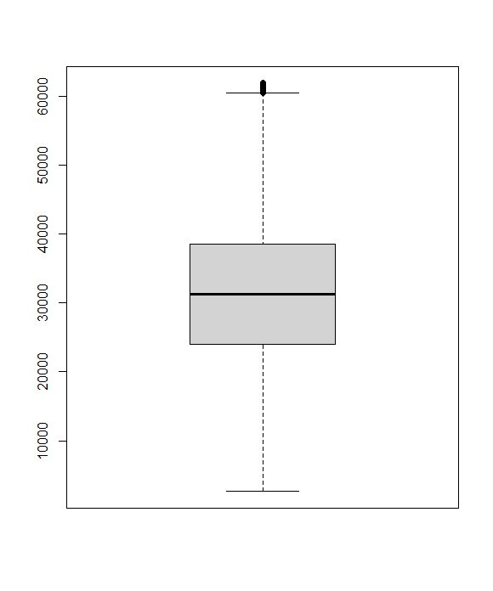





Removal of Outliers
Whiskers extend 1.5 times the IQR from quartiles, covering middle 50% of data. Outliers beyond this range were removed for robust analysis.
Before
After

Slide 8
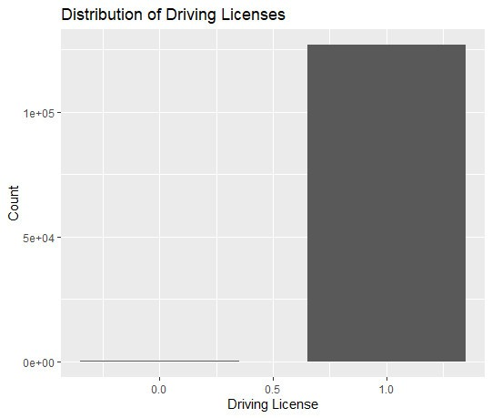

Distribution of Driving License
Outliers (237 values) lacking licenses but with car insurance hint at dataset anomalies, requiring investigation.
Driving License | 0 (No) | 1 (Yes)
Count | 237 | 126.800

Slide 9
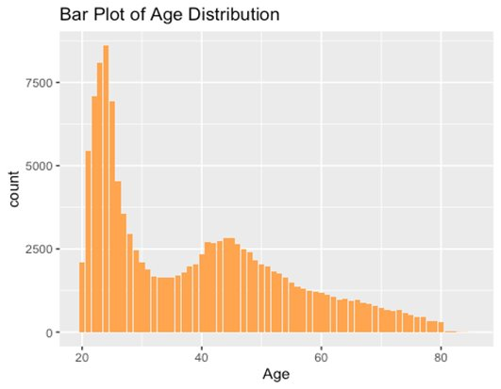
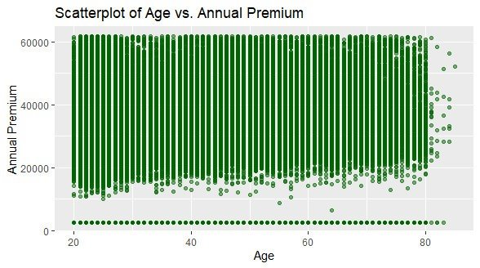

Age Distribution & Premium Analysis
Age 20-29 group most prevalent
Age correlates positively with premium
Some data points deviate, potentially due to accidents or unique insurance plans.

Slide 10
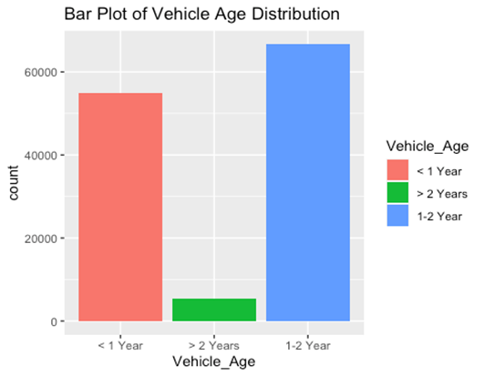

Vehicle Age Distribution
The bar chart reveals that most vehicles fall within 1 to 2 years age group, followed by vehicles less than 1 year old. Conversely, older vehicles exceeding 2 years are less prevalent in comparison

Slide 11
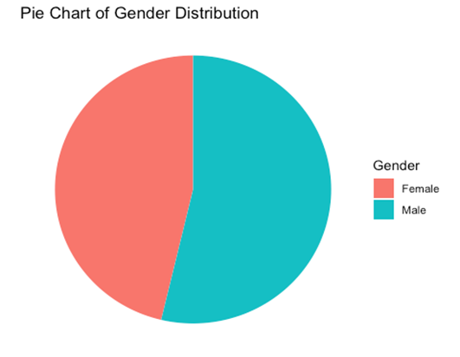
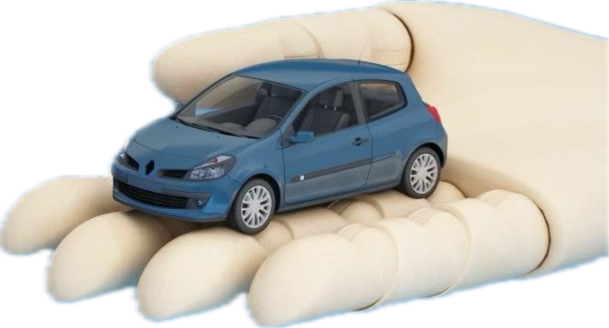
Gender-Based Insurance Premium Distribution
Gender-based analysis reveals that we have more male policyholders than women in our dataset.
The disparity in insurance premiums between genders may suggest an influence of gender as a significant predictor.

Slide 12

Regression
Results of
Model 1
Call: lm(formula = Annual_Premium ~ ., data = data_clean) Residuals: Min 1Q Median 3Q Max -39400 -5033 1110 7437 50544
Coefficients: (1 not defined because of singularities) Estimate Std. Error t value Pr(>|t|) (Intercept) -2.593e+04 9.210e+02 -28.158 < 2e-16 *** id 9.399e-04 9.655e-04 0.974 0.330288 GenderMale 1.432e+02 7.247e+01 1.975 0.048223 * Age 2.534e+01 3.969e+00 6.385 1.72e-10 *** Driving_License NA NA NA NA Region_Code1 1.344e+03 8.181e+02 1.643 0.100318 .......... Region_Code52 2.565e+04 1.411e+03 18.181 < 2e-16 *** Previously_Insured 3.114e+02 1.279e+02 2.434 0.014917 * Vehicle_Age> 2 Years -8.921e+02 2.536e+02 -3.518 0.000436 *** Vehicle_Age1-2 Year -2.969e+03 1.678e+02 -17.688 < 2e-16 *** Vehicle_DamageYes 5.100e+02 1.282e+02 3.980 6.91e-05 *** Policy_Sales_Channel2 3.165e+04 1.245e+04 2.542 0.011033 * ............
Policy_Sales_Channel163 2.384e+04 7.681e+02 31.040 < 2e-16 *** Vintage -1.034e-01 4.234e-01 -0.244 0.807152 --- Signif. codes: 0 ‘***’ 0.001 ‘**’ 0.01 ‘*’ 0.05 ‘.’ 0.1 ‘ ’ 1 Residual standard error: 12430 on 123193 degrees of freedom Multiple R-squared: 0.2909, Adjusted R-squared: 0.2897 F-statistic: 247.7 on 204 and 123193 DF, p-value: < 2.2e-16

Slide 13

Regression
Results of
Model 2
Call: lm(formula = Annual_Premium ~ . - id - Policy_Sales_Channel - Vintage - Driving_License, data = data_clean) Residuals: Min 1Q Median 3Q Max -38318 -4472 1846 8026 49529 Coefficients: Estimate Std. Error t value Pr(>|t|) (Intercept) 1873.75 533.04 3.515 0.00044 *** GenderMale 155.28 76.15 2.039 0.04144 * Age 78.59 4.01 19.600 < 2e-16 *** Region_Code1 -593.50 860.12 -0.690 0.49019
..........
Region_Code52 23509.47 1486.48 15.815 < 2e-16 *** Previously_Insured 1479.11 133.22 11.103 < 2e-16 *** Vehicle_Age> 2 Years -1454.22 240.81 -6.039 1.56e-09 *** Vehicle_Age1-2 Year -3555.95 130.43 -27.264 < 2e-16 *** Vehicle_DamageYes 364.71 133.30 2.736 0.00622 ** --- Signif. codes: 0 ‘***’ 0.001 ‘**’ 0.01 ‘*’ 0.05 ‘.’ 0.1 ‘ ’ 1 Residual standard error: 13110 on 123339 degrees of freedom Multiple R-squared: 0.2102, Adjusted R-squared: 0.2099 F-statistic: 566.1 on 58 and 123339 DF, p-value: < 2.2e-16
.

Slide 14

Regression
Results of
Model 3
Call: lm(formula = Annual_Premium ~ . - id - Policy_Sales_Channel - Vintage - Driving_License + Age * Vehicle_Age + Previously_Insured * Vehicle_Damage, data = data_clean) Residuals: Min 1Q Median 3Q Max -37967 -4625 1838 8029 49265 Coefficients: Estimate Std. Error t value Pr(>|t|) (Intercept) 13533.67 661.36 20.463 < 2e-16 *** GenderMale 222.21 75.71 2.935 0.00334 ** Age -433.58 15.70 -27.613 < 2e-16 *** Region_Code1 -796.35 854.87 -0.932 0.35157 ..........
Region_Code52 23228.79 1477.38 15.723 < 2e-16 *** Previously_Insured 2952.52 158.97 18.573 < 2e-16 *** Vehicle_Age> 2 Years -13884.24 1015.81 -13.668 < 2e-16 *** Vehicle_Age1-2 Year -18231.97 452.37 -40.303 < 2e-16 *** Vehicle_DamageYes 1854.50 158.76 11.681 < 2e-16 *** Age:Vehicle_Age> 2 Years 501.29 22.91 21.877 < 2e-16 *** Age:Vehicle_Age1-2 Year 550.81 16.26 33.875 < 2e-16 *** Previously_Insured:Vehicle_DamageYes -5610.75 285.08 -19.681 < 2e-16 *** --- Signif. codes: 0 ‘***’ 0.001 ‘**’ 0.01 ‘*’ 0.05 ‘.’ 0.1 ‘ ’ 1 Residual standard error: 13030 on 123336 degrees of freedom Multiple R-squared: 0.2199, Adjusted R-squared: 0.2195 F-statistic: 570 on 61 and 123336 DF, p-value: < 2.2e-16

Slide 15


Model 3 Analysis Highlights
Model 3 introduces interaction terms to capture non-linear relationships and potential correlations between variables.
Interaction terms such as 'Age:Vehicle_Age' and 'Previously_Insured:Vehicle_Damage' encapsulate nuanced effects.
Model 3 exhibits a marginally lower Residual Standard Error (13030) than Model 2 (13110), hinting at a potentially better fit.
The Adjusted R-squared in Model 3 (0.2195) slightly surpasses Model 2 (0.2099), indicating enhanced explanatory capability.

Slide 16

Model | Residual Standard Error | Adjusted R-squared | Explanation
Model 1 | 12430 | 0.2897 | Has the lowest error and highest explanatory power.
Model 2 | 13110 | 0.2099 | Has higher error and lower explanatory power than Model 1.
Model 3 | 13030 | 0.2195 | Incorporates interaction terms to capture nuanced relationships, potentially improving predictive accuracy.

Slide 17
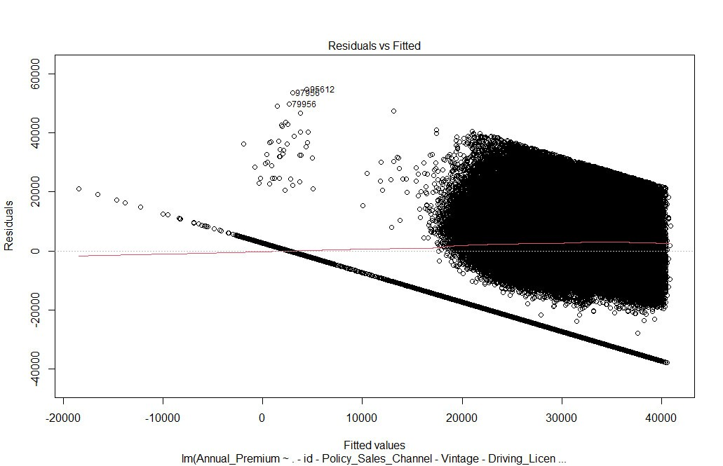


Residuals Plot of Model 3

Slide 18

Polynomial Regression
Results of
Model 3
Call:​ lm(formula = Annual_Premium ~ . + I(Age^2) + sqrt(Age) - id - ​ Policy_Sales_Channel - Vintage - Driving_License + Age * ​ Vehicle_Age + Previously_Insured * Vehicle_Damage, data = data_clean)​ ​ Residuals:​ Min 1Q Median 3Q Max ​ -37105 -4609 1808 7999 49163 ​ ​ Coefficients:​ Estimate Std. Error t value Pr(>|t|) ​ (Intercept) -44275.342 6866.249 -6.448 1.14e-10 ***​ GenderMale 200.918 75.703 2.654 0.00795 ** ​ Age -2963.742 346.155 -8.562 < 2e-16 ***​
I(Age^2) 5.401 1.179 4.579 4.67e-06 ***​ sqrt(Age) 23578.335 2953.512 7.983 1.44e-15 ***​ Region_Code1 -725.189 854.037 -0.849 0.39581 ​
...... ​
Region_Code52 23424.821 1475.854 15.872 < 2e-16 ***​ Previously_Insured 2836.293 159.141 17.823 < 2e-16 ***​ Vehicle_Age> 2 Years -26210.832 1276.044 -20.541 < 2e-16 ***​ Vehicle_Age1-2 Year -28642.767 822.066 -34.842 < 2e-16 ***​ Vehicle_DamageYes 1779.871 158.657 11.218 < 2e-16 ***​ Age:Vehicle_Age> 2 Years 834.263 31.674 26.339 < 2e-16 ***​ Age:Vehicle_Age1-2 Year 849.564 26.226 32.394 < 2e-16 ***​ Previously_Insured:Vehicle_DamageYes -5328.707 285.353 -18.674 < 2e-16 ***​ ---​ Signif. codes: 0 ‘***’ 0.001 ‘**’ 0.01 ‘*’ 0.05 ‘.’ 0.1 ‘ ’ 1​ ​ Residual standard error: 13020 on 123334 degrees of freedom​ Multiple R-squared: 0.2216, Adjusted R-squared: 0.2212 ​ F-statistic: 557.3 on 63 and 123334 DF, p-value: < 2.2e-16​

Slide 19

Insights from Regression Analysis on Insurance Premium Determinants
Age demonstrates a non-linear relationship with annual premiums, indicated by the inclusion of polynomial terms (Age^2 and √Age).
Significant predictors such as Region Code and Vehicle Age play crucial roles in determining premiums.
Age exhibits a negative linear effect alongside positive quadratic and squareroot effects on premiums, revealing a complex relationship.
Gender, Vehicle_Age, Vehicle_Damage, and Previously_Insured also exert significant effects on premiums, emphasizing the diverse factors influencing insurance costs.

Slide 20

Model Evaluation & Strategic Perspectives
Regression models demonstrate robust predictive power, influenced by key factors such as age, prior insurance status, vehicle age, and damage. These findings directly inform pricing strategies, enhancing accuracy and risk assessment for insurers and policyholders.
By integrating these insights into pricing models, insurers can tailor offerings more effectively, improving competitiveness and customer satisfaction. The benefits extend to both insurers and policyholders, fostering a more sustainable and efficient insurance marketplace.

Slide 21




Thank You!

Slide 22
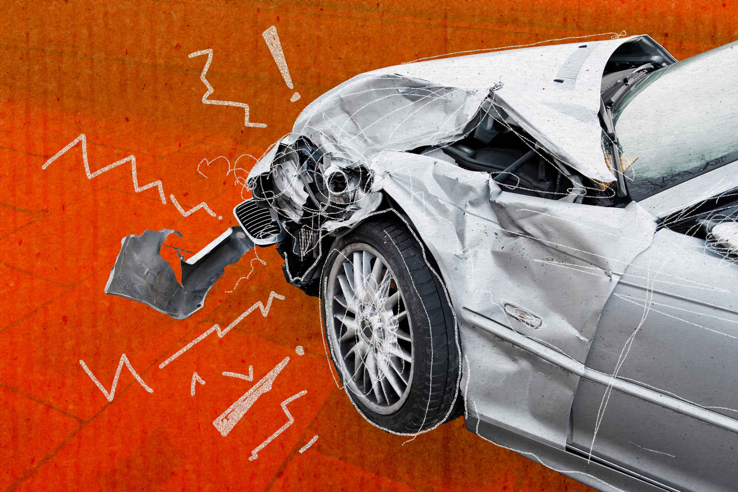
QUESTIONS?!

